Slide 1
The Roll System Using Mobile Device
Group 1

Slide 2
Team Member
Supervisor: Kiều Trọng Khánh
Phạm Huy Hoàng
Nguyễn Thanh Bình
Nguyễn Quốc Huy
Đõ Minh Đạt

Slide 3
Outline
Scenario Problem
Propose our solution
Demostration
Advantages & Disadvantages of current scenario
Techology and development evironment
Advantages
Disadvantage & Future Plan

Slide 4








Traditional Method
Student
Instructor
Roll Call Book
Student
Information and Report
Student
Instructor
Roll Call Book
Student

Slide 5
Advantages
Disavantage
Low cost.
Easy to setup.
No Training Time.
Paper Document
Ineffective manual work
No Report Support

Slide 6






Fingerprint Recognition Method
Student
Instructor
Browser
Fingerprint
Recognition
Device
Student
Student
Stored
Information and Report
Fingerprint
Recognition
Device
Student

Slide 7
Advantages
Disavantage
Less Manual Work
Fast & Convinient
Support
Statics & Report
High Installation Cost
Machine Error
Students don’t go to class

Slide 8

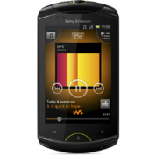



Proposed scenario
Student
Staff
Cellphone
Instructor
Browser
Instructor
Stored
Information and Report
Web Services
Students

Slide 9
Features
Check Attendance
Face Recognition
Export Excel Report
Offline Data Sync
Mobile Application
Google Calendar Sync

Slide 10
Demo scenario
Display Student Images and current Roll Calls in System
Check Attendance by Taking Picture
Check Attendance Manually
(Web & Mobile)
Check Attendance Offline & Sync Data Online
Export Excel Report (Instructor & Staff)
Manage Study Session. Sync Calendar to Google Calendar

Slide 11

Demo

Slide 12

Check Attendance Auto
Instructor
Web Services
Attendance Checking
Students

Slide 13
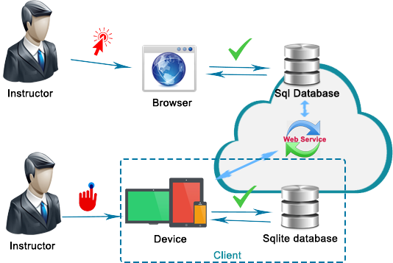
Check Attendance Offline

Slide 14
Advantages
Fast, convinient roll call system. The attendance checking only take 10-30s for each session.
Small installation cost.
Easy deployment (Just web server + mobile).
Less hand work.
Offline working and data synchronization, in case of network error.

Slide 15

Disadvantage
The accuracy is still not 100%. (Just 70-80% according to test report).
Only export one kind of report.
Not auto-arrange/manage the teaching calendar of instructor.
Mobile App only on 1 platform: Android

Slide 16


Future Plan
Find another face-recognition algorithm or optimize the current algorithm for higher accuracy.
Export more kind of report: Absent rate of a subject, a student.
Develop mobile app on another platform: iOS, Window Phone…

Slide 17
THANK YOU
Q/A

